Slide 1
Background templates

Slide 2
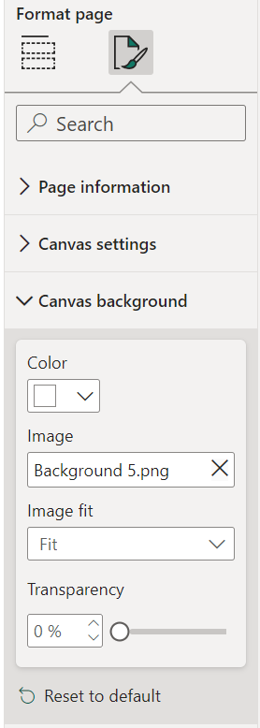
How to design Power BI background in PowerPoint?
In the following pages, you will find some Power BI background templates to recycle for your dashboards
Replace with the colors you would like to have for your dashboard background
Save: Select all objects on the page > Right click > Save as Picture
In Power BI file, go to Format page, browse for the saved picture
Do the same for other pages
Browse for the saved background picture
Choose Fit

Slide 3
Shape outline for you to easy to see the object. Remove the shape outline after replacing the color

Slide 8



For other icons from PowerPoint: Insert > Icons
You can easily change the color of the icons

Slide 11
Well-designed dashboards for inspiration

Slide 12
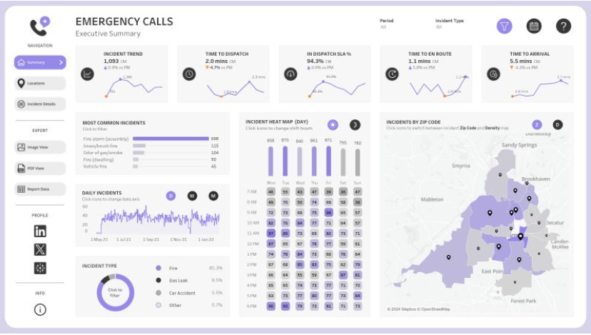

Slide 13
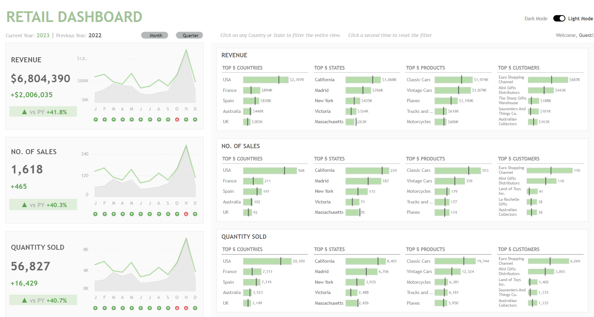

Slide 14
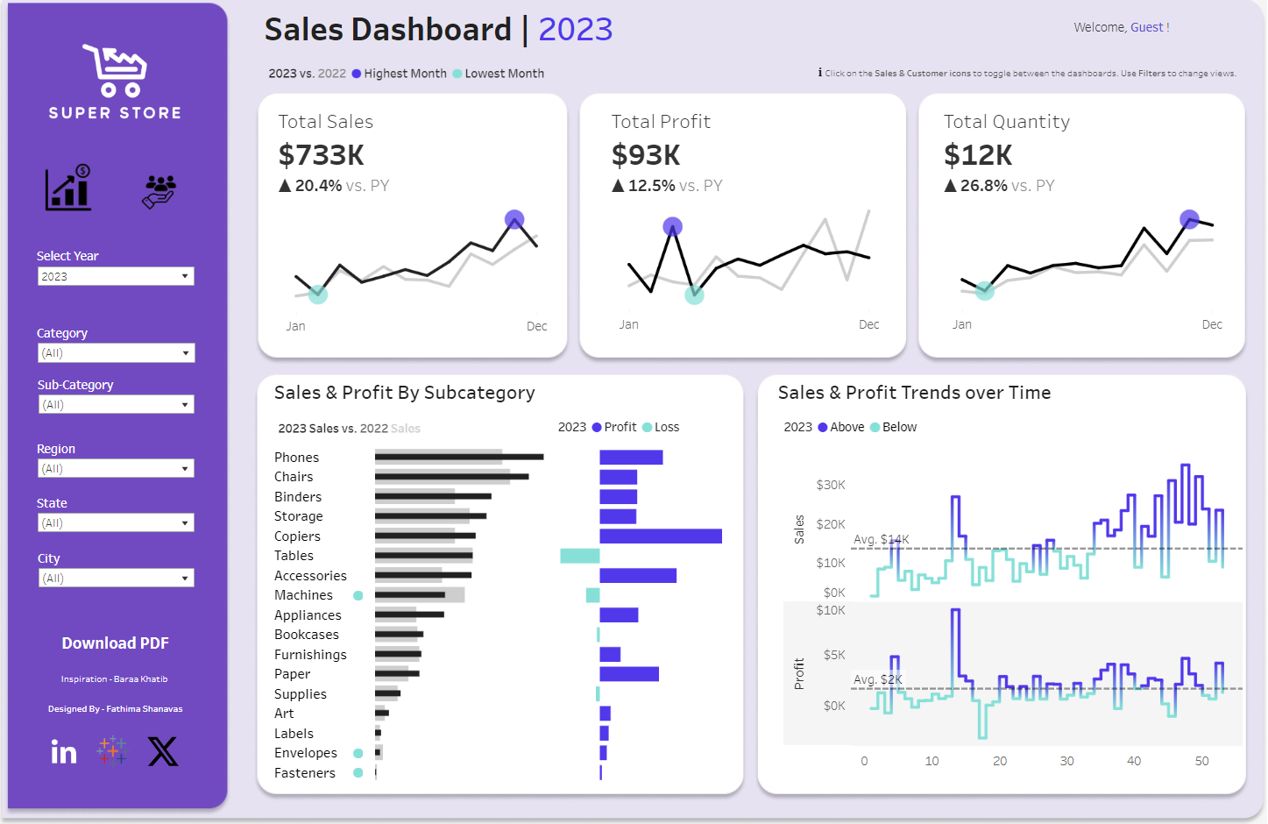

Slide 15
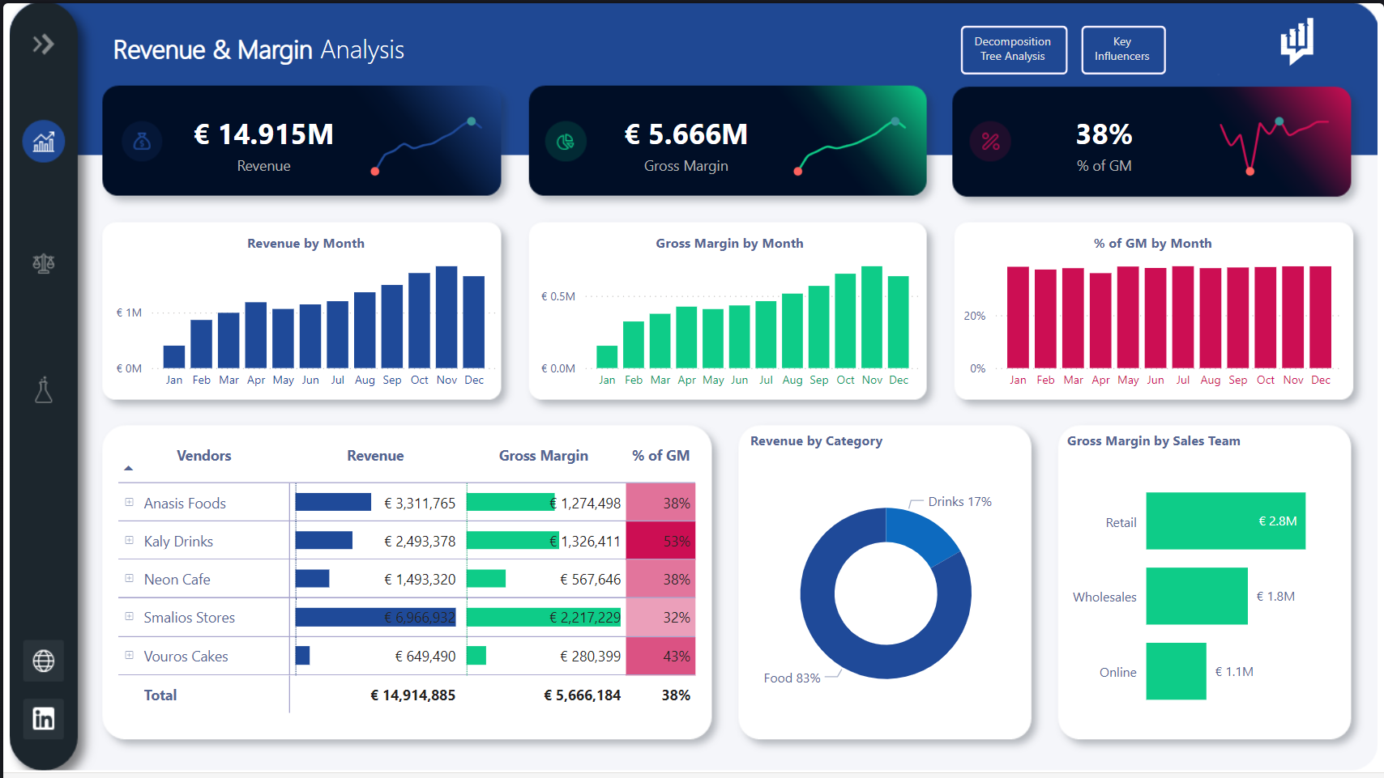
Notes:
https://www.novypro.com/projects?Popup=memberProject&Data=1682143962550x118389682728120780

Slide 16
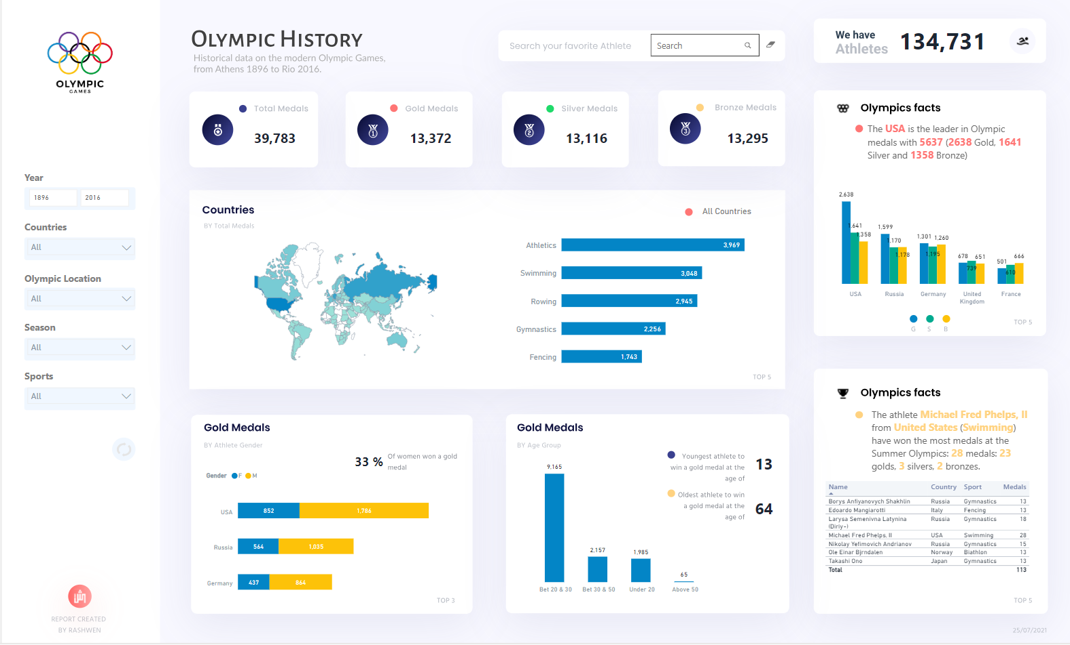
Notes:
https://www.novypro.com/projects?Popup=memberProject&Data=1682147745180x965292778411445100

Slide 17
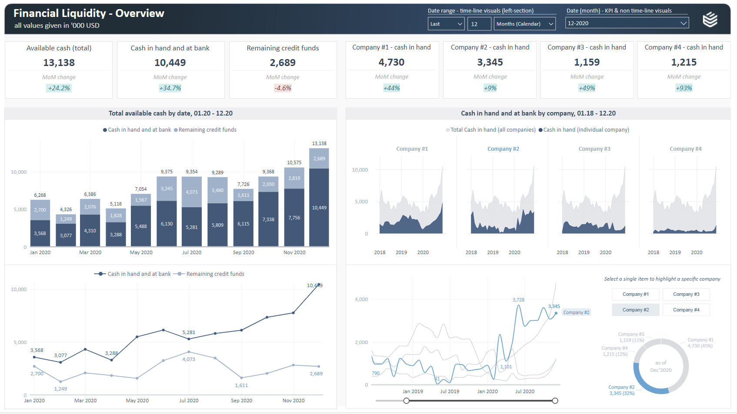
Notes:
https://www.novypro.com/projects?Popup=memberProject&Data=1682148525618x396702591045909900

